Slide 1




2023
ASDS Consumer Survey
on Cosmetic Dermatologic Procedures
Presented by the
American Society for Dermatologic Surgery

Slide 2

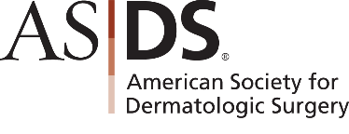
ABOUT THE SOCIETY
The Skin Health and Beauty Experts
The American Society for Dermatologic Surgery (ASDS) is the largest specialty organization exclusively representing dermatologic surgeons who have the unique training and experience required to treat the health, function and beauty of patients’ skin, hair and nails throughout every stage of life. For more than 50 years, ASDS members have been recognized as leaders in the field of cosmetic and medically necessary skin surgery.

Slide 3

Methodology
Developed by ASDS Survey Work Group
Online survey fielded by PureSpectrum May 11 to May 30, 2023
3,503 respondents
Survey split into four parts with some overlapping questions
American Society for Dermatologic Surgery | 2023

Slide 4

70%
OF CONSUMERS
are considering a
cosmetic procedure.
American Society for Dermatologic Surgery | 2023

Slide 5

Why are consumers considering cosmetic procedures?
I want to feel more confident.
I want to do something for myself / reward myself.
I want to appear more attractive.
I want to look as young as I feel or better for my age.
These top concerns have been consistent since 2019.
American Society for Dermatologic Surgery | 2023

Slide 6
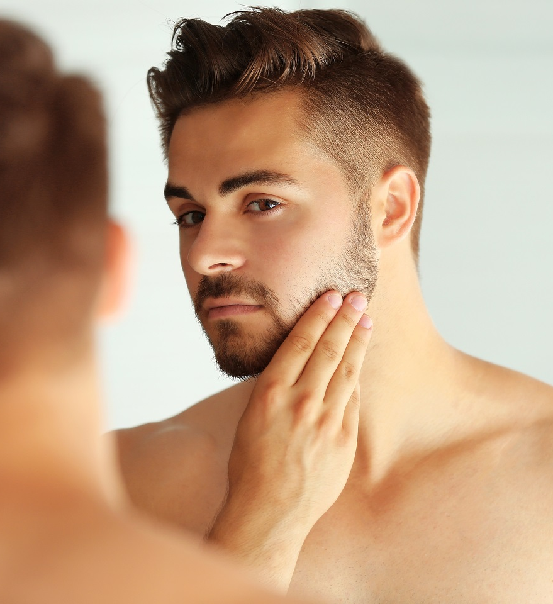
Which cosmetic concerns are most bothersome to consumers?
Excess weight on any part of the body (87%)
Skin texture and/or discoloration (80%)
Lines and wrinkles around and under the eyes (79%)
Excess fat under the chin / neck (79%)
Cellulite (72%)
Cellulite is a new leading concern for 2023.
American Society for Dermatologic Surgery | 2023

Slide 7

Why are consumers waiting for cosmetic procedures?
Cost
May be painful
Concerns about side effects and safety
May not obtain the desired results
Side effects and safety concerns are a new top concern for 2023.
American Society for Dermatologic Surgery | 2023

Slide 8

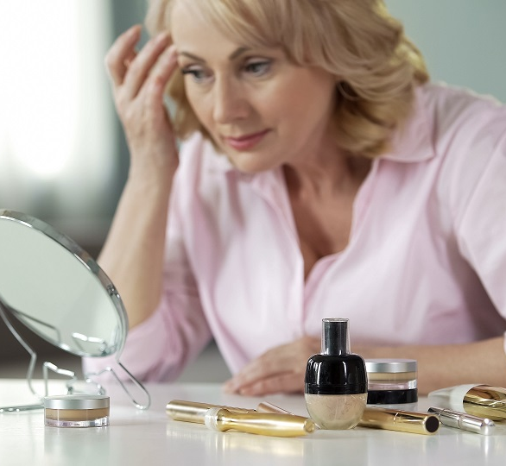
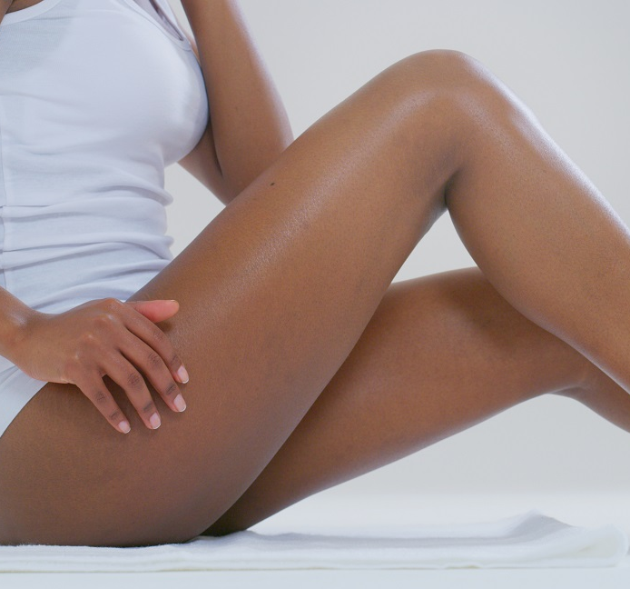
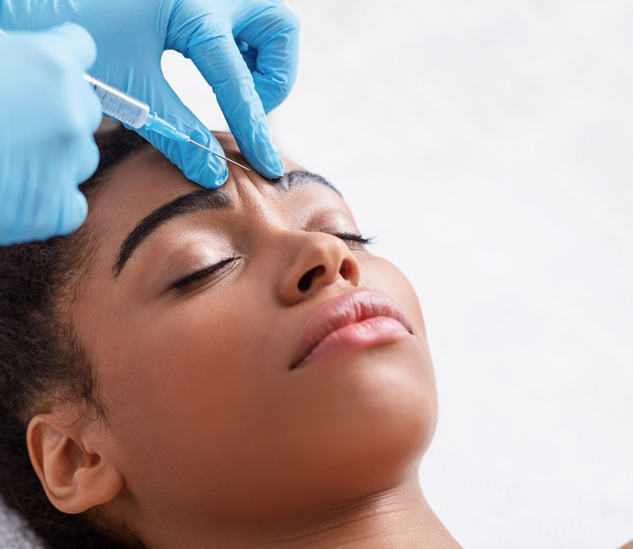

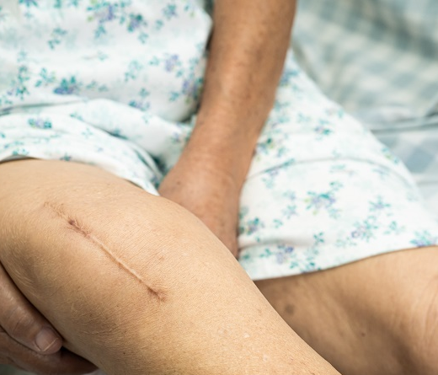
Top 5 Cosmetic Procedures Consumers Are Considering
Laser / Energy-Based Devices for Skin Tighten
(53%)
Body Sculpting
(52%)
Injectable Wrinkle Relaxers
(49%)
Laser Hair Removal
(45%)
Laser / Energy-based Devices for Skin Tone and Scars
(44%)
Consistent popularity of laser and injectable treatments since 2018.
American Society for Dermatologic Surgery | 2023

Slide 9

Top Cosmetic Procedure
Satisfaction Ratings *
Vein Treatments
Platelet Rich Plasma
Thread Lifts
Muscle Sculpting
Wrinkle Relaxers
Laser Tattoo Removal
Chemical Peels
Microdermabrasion
Fillers
*95% or higher
9 out of 15 treatments received 95%
or higher overall satisfaction ratings
American Society for Dermatologic Surgery | 2023

Slide 10
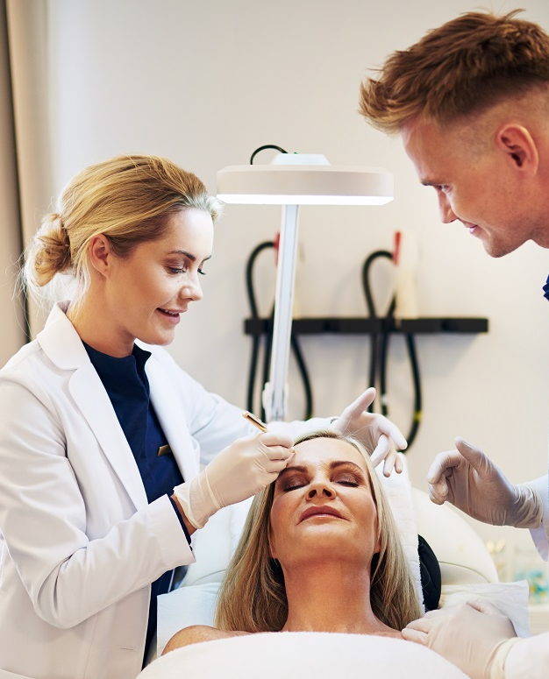

Dermatologists:
#1
most influential on cosmetic procedures and skin care purchases
American Society for Dermatologic Surgery | 2023

Slide 11

Top Factors That Influence the Selection of a Provider
Price (33%)
Specialty in which the physician is board certified (23%)
Before-and-after photos (23%)
Referral from a physician (22%)
Referral from a friend (22%)
The level of licensure of the provider (21%)
Specialty’s influence increased by 12% over the previous survey.
American Society for Dermatologic Surgery | 2023

Slide 12

In addition to influencing factors, what resources led consumers to select their cosmetic procedure provider?
Friend recommendation (16%)
Referral from a physician (15%)
Google search (14%)
Family recommendation (13%)
Social media (12%)
Online resources continue to gain influence on provider choice.
American Society for Dermatologic Surgery | 2023

Slide 13

Skin Care Product Purchases
Monthly Spend
$1 - $50 (33%)
$51 - $100 (31%)
$101 - $150 (20%)
More than 20% of consumers are spending up to $1,200+ annually for skin care products.
American Society for Dermatologic Surgery | 2023

Slide 14

Dermatologists: Physician of choice in 9 categories
Injectable Wrinkle Relaxers
Injectable Fillers
Platelet Rich Plasma (new for 2023)
Chemical Peels
Microneedling (new for 2023)
Vein Treatments
Thread Lifts (new for 2023)
Micro-coring (new for 2023)
Laser Tattoo Removal
Of patients that saw a dermatologist, more than 70% were an ASDS member.
American Society for Dermatologic Surgery | 2023

Slide 15
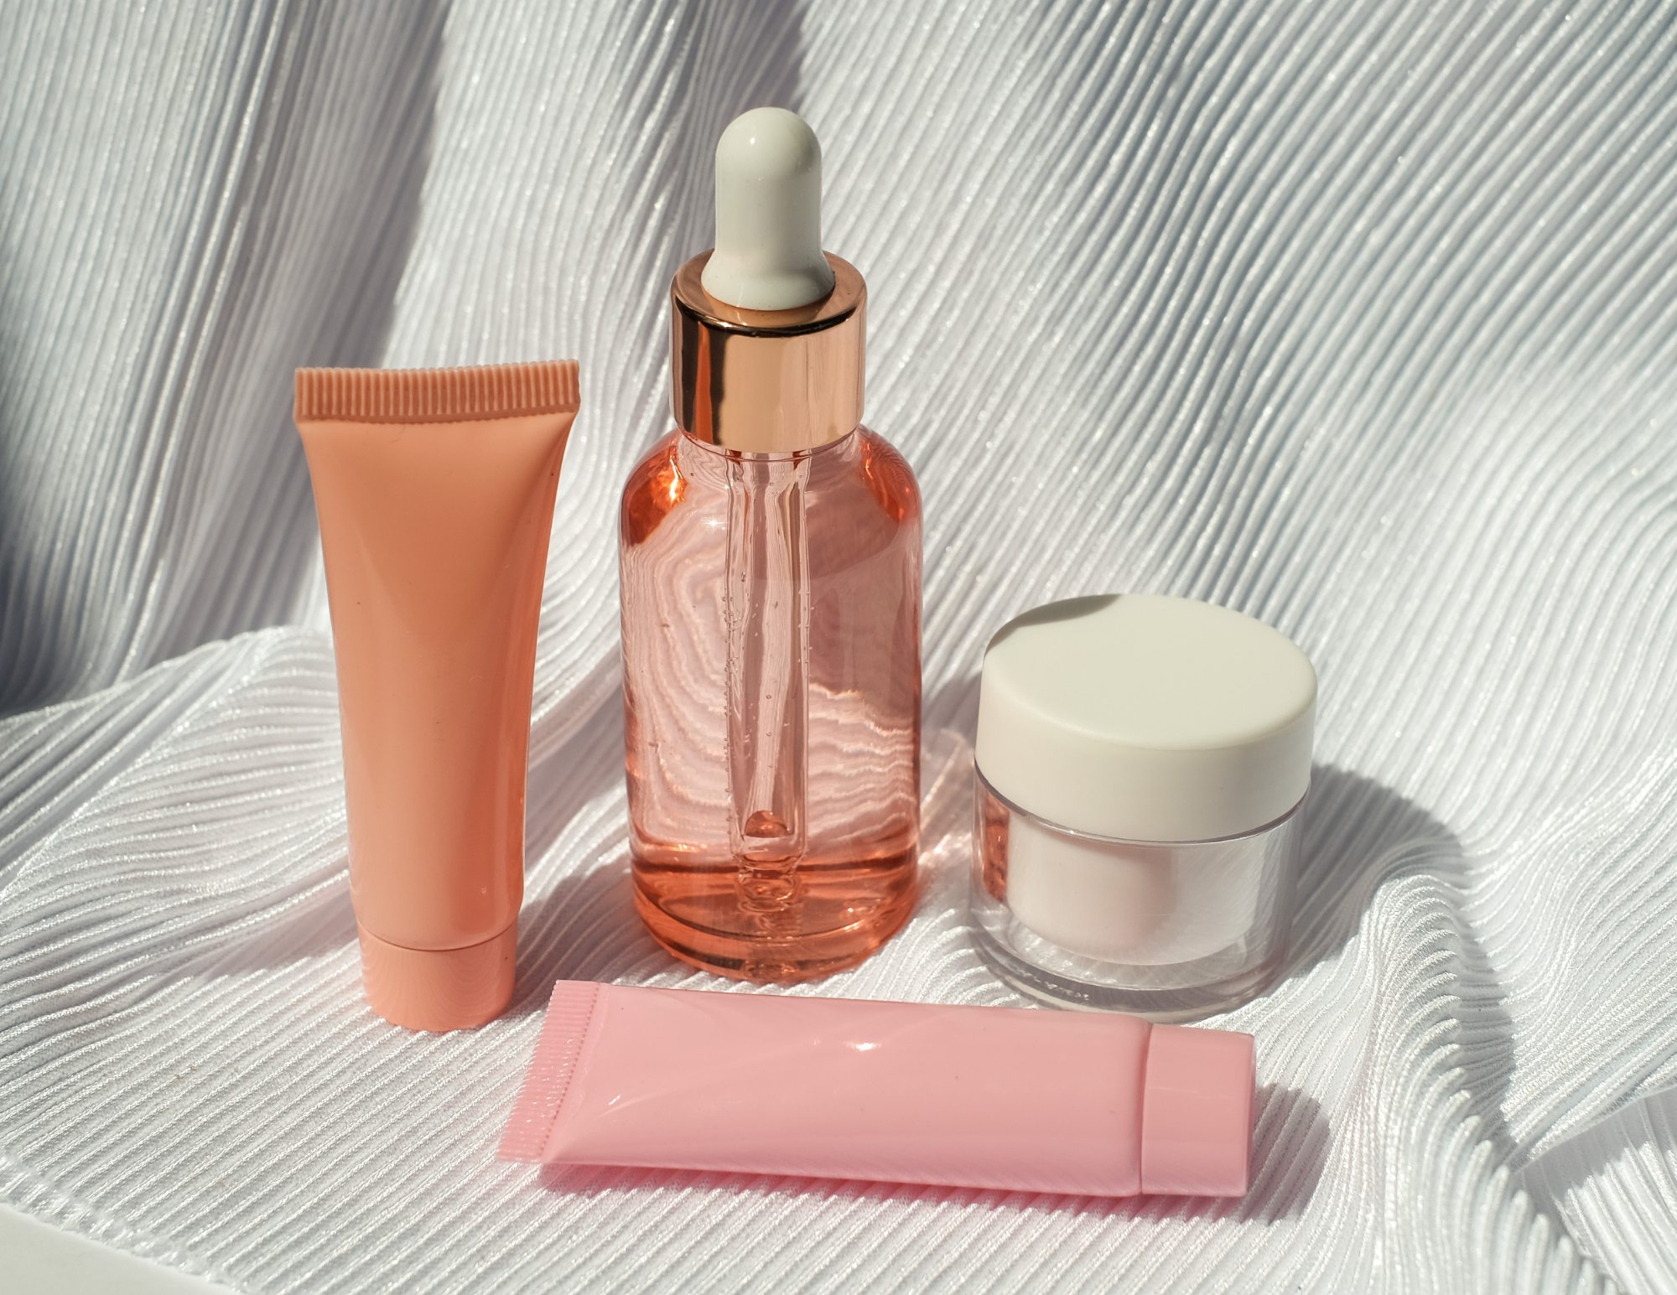
Who has the most influence on skin care purchases?
Dermatologist
Social Media
Relatives
Friends
Primary Care Physicians
Dermatologists have ranked #1
since 2018.
American Society for Dermatologic Surgery | 2023

Slide 16


INFLUENCE
Information Channels
Influencing Consumer Behavior
American Society for Dermatologic Surgery | 2023

Slide 17

What digital resources
influence skin health
decisions?
Facebook (15%)
Instagram (12%)
YouTube (11%)
Physician Website (10%)
Online Magazines (8%)
2023 is the
first-time social media platforms held
the top 3 digital resources for skin health decisions.
American Society for Dermatologic Surgery | 2023

Slide 18

The Social Media Impact
Top Platforms
More than half of consumers say a provider’s social media presence impacts their decision to schedule an appointment.
73% of consumers follow the social media account of the provider they are seeing or considering seeing.
Facebook (21%)
YouTube (18%)
Instagram (17%)
Twitter (10%)
TikTok (10%)
American Society for Dermatologic Surgery | 2023

Slide 19

Which rate and review sites
are most utilized?
Facebook (18%)
WebMD (15%)
Physician Website (13%)
Google My Business (12%)
Yelp (10%)
84% of consumers say rate and review sites impact their decision on choosing a cosmetic procedure provider.
American Society for Dermatologic Surgery | 2023

Slide 20

Executive Summary
Dermatologists consistently rank #1 influencers for both cosmetic procedures and skin care decisions.
Increasing influence of the specialty in which a physician is board certified.
70% of consumers are considering cosmetic procedures.
Consistent popularity of injectables, body sculpting and laser-based procedures.
Potential side effects and safety concerns are a top reason for waiting on cosmetic procedures.
Dermatologists are leading the newest procedures with high rates of patient satisfaction.
Of dermatologist physicians of choice, 70% were ASDS members.
Social Media and Rate and Review sites continue to gain influence on consumers’ skin health decisions.
A provider’s social media presence has a growing impact on consumers becoming patients and engaging with their providers.
American Society for Dermatologic Surgery | 2023

