Slide 1
Survey Work Group Consumer Survey Update
Nazanin Saedi, MD, Co-chair

Slide 2
Work Group Members
Sheila Farhang, MD
Rawaa Almukhtar, MD
Niquette Hunt, Candesant
Jim Hartman, Hugel Aesthetics
Diane Berson, MD, Chair
Nazanin Saedi, MD, Co-Chair
Charles Sola, MD
Eric Bernstein, MD
Hayley Goldbach, MD

Slide 3
2021 ASDS Consumer Survey on Cosmetic Dermatologic Procedures

Slide 4
Methodology
Developed by ASDS Survey Work Group
Online survey fielded by PureSpectrum Oct. 20, 2021, to Nov. 9, 2021
3,527 respondents
Survey split in four parts with some overlapping questions

Slide 5
Who has the most INFLUENCE on having
a PROCEDURE and SKIN CARE purchases?
Out of 16 factors influencing these decisions,
DERMATOLOGISTS Ranked No. 1
#1 ranking in 3 consecutive surveys!

Slide 6
Physician of choice in 7 categories: DERMATOLOGIST
1
Injectable wrinkle-relaxers
Laser / light therapy for skin redness, tone and scars Laser/ light therapy for skin tightening
Chemical Peels
Varicose and spider vein treatments
Microdermabrasion
Tattoo Removal
1
2
1
3
1
4
1
5
Of those that saw a dermatologist, more than 66% were an ASDS member.
1
6
7
1

Slide 7
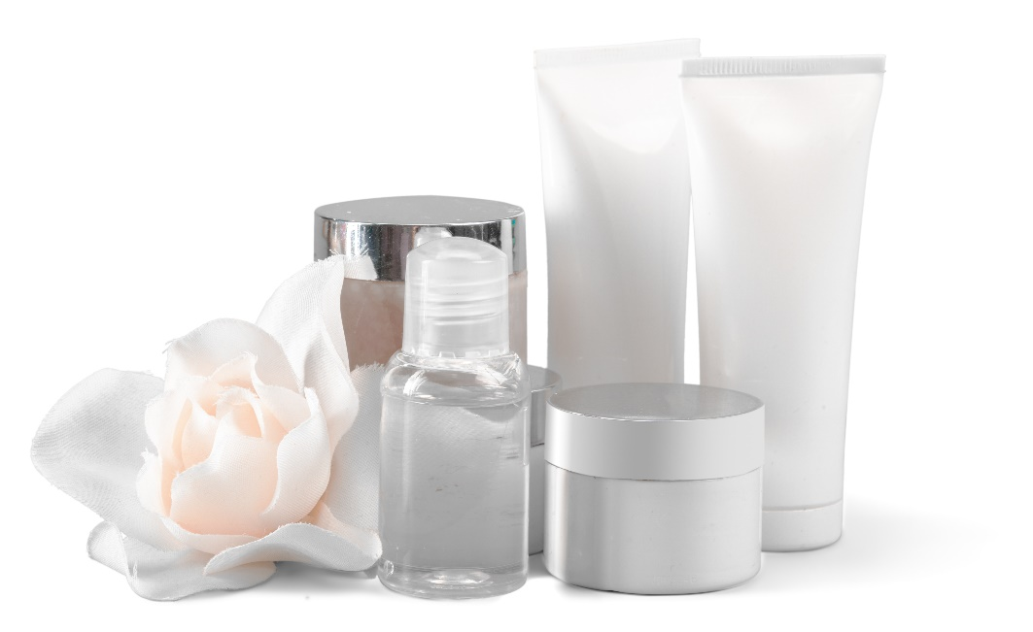
Who has the most INFLUENCE on SKIN CARE purchases?
Top 5 of 16 factors influencing the decision to have a procedure:
32% DERMATOLOGIST
31% Social Media
24% Relatives
24% Friends
24% Primary Care Physician
Dermatologists
rank #1 since 2018.

Slide 8
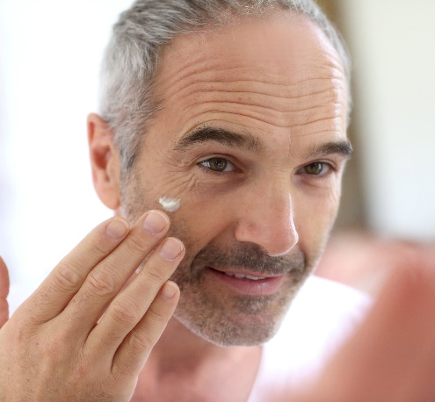
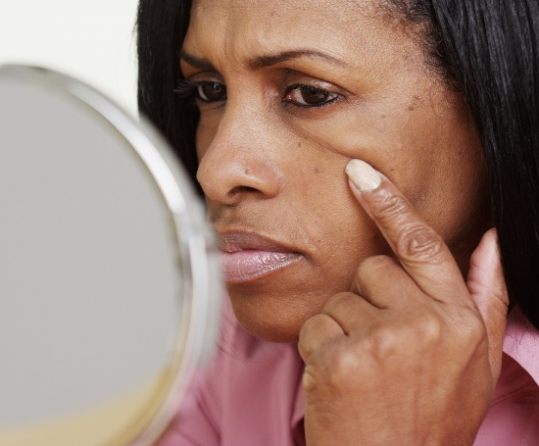
70%
ALMOST of consumers are considering a
COSMETIC PROCEDURE

Slide 9
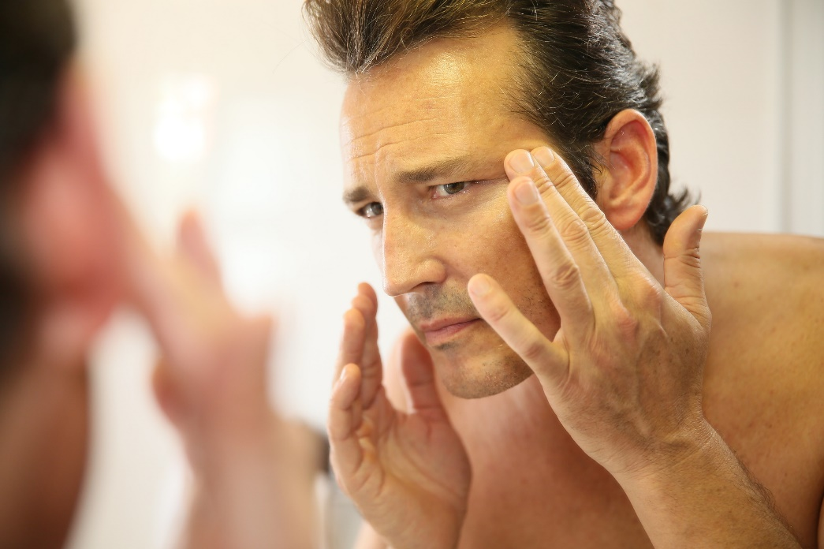
WHY are consumers exploring cosmetic procedures?
I want to feel more confident.
I want to appear more attractive.
I want to do something for / reward myself.
I want to look as young as I feel for my age.

Slide 10
Consumers MOST bothered by…
Excess fat on any part of the body 77%
Excess fat under the chin or neck 70%
Skin texture and/or discoloration 66%
Lines and wrinkles around and under the eyes 62%
Hair Loss 60%
Excessive Sweating 58% *
*New to the survey for 2021
Hair loss increased by 7% from 2019.

Slide 11
Top Procedures consumers are considering… 52% Ultrasound, laser, light and radiofrequency treatments for skin tightening and wrinkles
48% Laser, light therapy to reduce facial redness, improve skin tone or improve scars
48% Injectable wrinkle-relaxers
47% Body Sculpting
44% Microdermabrasion
5

Slide 12
Why are consumers WAITING?
Top 5 reasons:
Cost
May be painful
May not get the results I’m looking for
Length of recovery time
Worried the change will be too radical
First time “too radical of a change” made the top 5, reflective of the desire for a natural look.
© Copyright ASDS 2017. Confidential: Do not distribute or disseminate.

Slide 13
What has the most INFLUENCE on PRACTITIONER?
Top 3 of 11 factors influencing the selection of a practitioner: 44% Price
36% Level of Licensure of the Practitioner
33% Before and After Photos*
33% Specialty the Physician is Board Certified
*New for 2021

Slide 14
Top SATISFACTION Ratings*
Injectable wrinkle-relaxers
Injectable fillers
Laser tattoo removal
Vein Treatments
Body Sculpting Treatments
Microdermabrasion
*95% or higher

Slide 15
Monthly Cost on Personal SKIN CARE Products
Most popular price ranges for monthly consumer spending on skin care products.
32% $1 - $50
31% $51 - $100
20% $101 - $150
$101-150 range increased 18% since 2019.
© Copyright ASDS 2017. Confidential: Do not distribute or disseminate.

Slide 16
The SOCIAL MEDIA Channels
Top 3 platforms:
21% Facebook
19% YouTube
17% Instagram
52% of consumers say a provider’s social media presence impacts their decision to schedule an appointment – a
9% increase over 2019.

Slide 17
What DIGITAL SOURCES influence skin health decisions?
Top 4 sources:
15% Facebook
12% Physicians Website
11% YouTube
10% Instagram
78% of consumers follow the social media of the provider they are seeing or considering seeing – a 38% jump from 2019.

Slide 18
Does SOCIAL MEDIA influence PROCEDURES and SKIN CARE purchases?
Digital conversations are impacting consumer behavior.
31% Skin Care (Top 3 Influencers)
23% Procedures (Top 3 Influencers)

Slide 19
What rate and review sites are most utilized?
Top 5 sites visited:
20% Facebook
14% Physician Website
13% WebMD
9% Doctor.com
9% Healthgrades
83%
of consumers say rate & review sites impact their decision on a cosmetic procedure provider – a 16% increase from 2019.

Slide 20
Summary
Dermatologists are ranked as the No.1 influencer on whether to have a cosmetic procedure and for skin care decisions.
Level of licensure and specialty a physician is board certified ranked as top factors influencing the selection of a practitioner.
Of dermatologist physician of choice, more than 66% were an ASDS member.
Almost 70% of consumers are considering cosmetic procedures.
Social media and rate and review sites continue to grow influence for consumers becoming patients.
A provider’s social media presence is an increasing factor in consumers provider selection.

