Slide 1

2019
ASDS Consumer Survey
on Cosmetic Dermatologic Procedures

Slide 2

Methodology
Developed by ASDS Survey Work Group
Online survey fielded by Survata
July 30 to Aug. 27, 2019
3,645 respondents
Survey split in four parts with some overlapping questions

Slide 3

Who has the most INFLUENCE on having
a PROCEDURE and SKIN CARE purchases?
Out of 15 factors
influencing these decisions,
DERMATOLOGISTS Ranked No. 1

Slide 4

Physician of choice in 5 categories:
DERMATOLOGIST
1
Injectable wrinkle-relaxers
Soft-tissue fillers
Laser / light therapy for skin redness, tone and scars
Varicose and spider vein treatments
Tattoo Removal
2
3
Of those that saw a dermatologist, more than 60% were an
ASDS member.
4
5

Slide 5
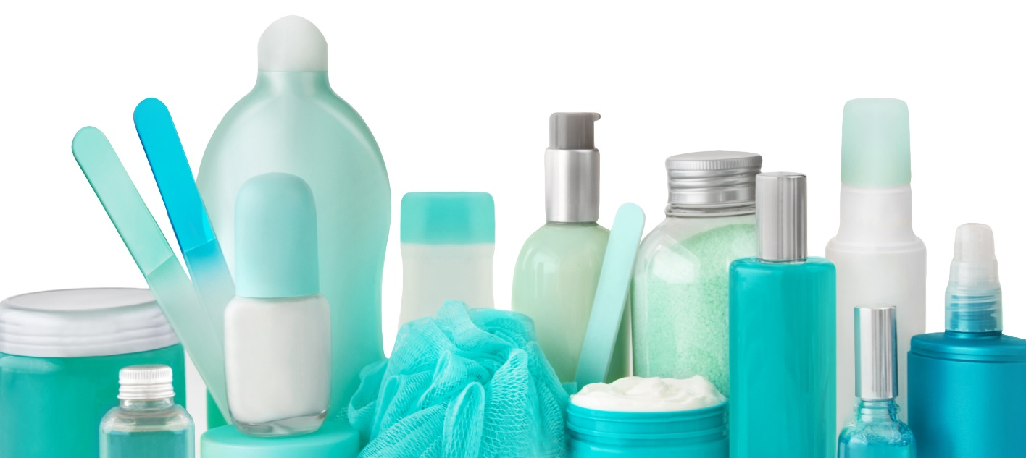
Who has the most INFLUENCE on SKIN CARE purchases?
Top 3 of 14 factors influencing
the decision to have a procedure:
45% DERMATOLOGIST
32% Friends
28% Social Media

Slide 6

Does SOCIAL MEDIA influence
PROCEDURES and SKIN CARE purchases?
Digital conversations are impacting
consumer behavior.
28% Skin Care
24% Procedures

Slide 7

The SOCIAL MEDIA Channels
Top 3 platforms:
26% Facebook
19% YouTube
17% Instagram
43%
A provider’s social media presence impacts consumers’ decision to schedule an appointment.

Slide 8

What DIGITAL SOURCES influence skin health decisions?
Top 4 sources:
15% Physician Website
14% Facebook
11% Online Magazines
10% YouTube
41%
Follow the social media of the provider they are seeing or consider seeing.

Slide 9

The Digital Content Followed
Of the consumers polled on the online social content they are following, influencers have the largest share of consumer attention.
95% Influencers/Celebrities
3% Publication/News Sources
1% Retailers
0.6% Physician
0.6% Medical Association

Slide 10

What Rate & Review sites are most utilized?
Top 5 sites visited:
20% WebMD
12% Facebook
11% Physician Website
11% Yelp
10% Healthgrades
69%
of consumers say rate & review sites impact their decision on a cosmetic procedure provider.
© Copyright ASDS 2017.
Confidential: Do not distribute or disseminate.

Slide 11
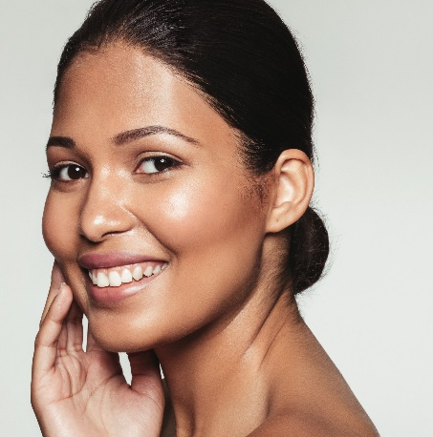
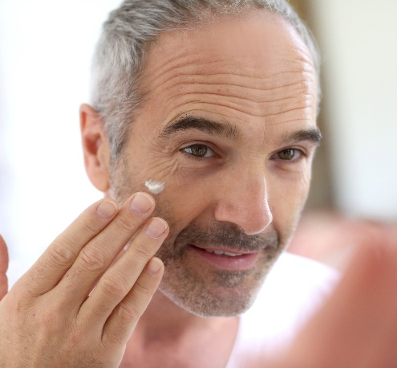
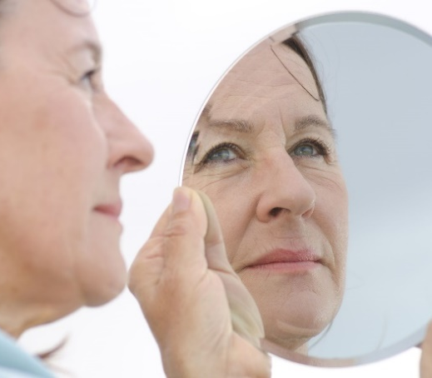
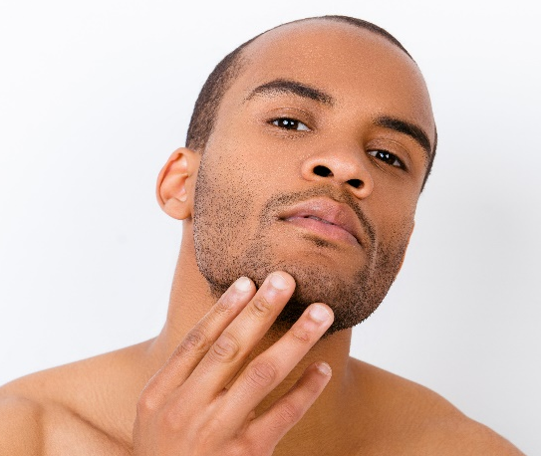
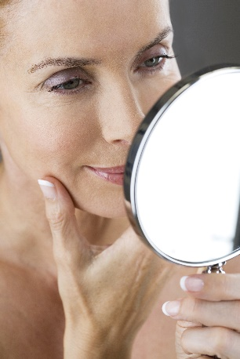
70%
ALMOST
of consumers are considering a
COSMETIC PROCEDURE.

Slide 12
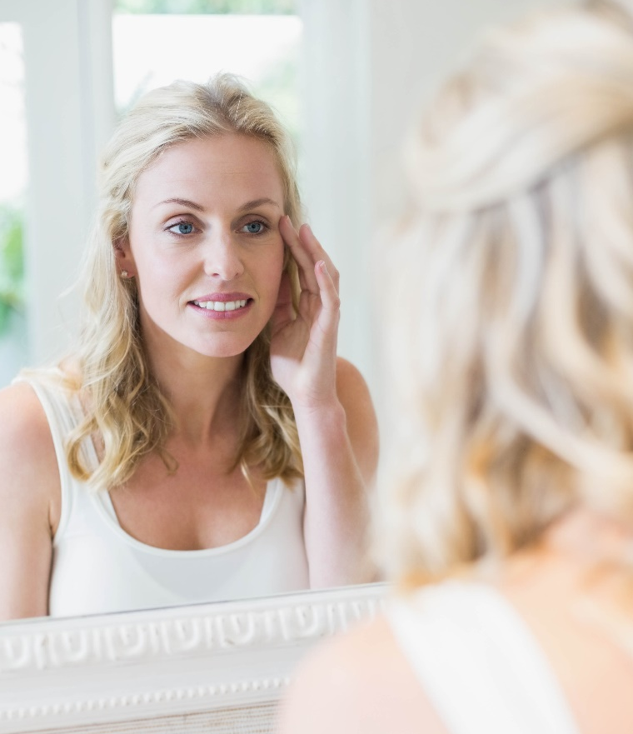
WHY are consumers exploring cosmetic procedures?
Top reasons for 7 consecutive years!
I want to feel more confident.
I want to appear more attractive.
I want to look as young as I feel for my age
I want to do something for myself/reward. *
*New for 2019 and tied among top reasons.

Slide 13
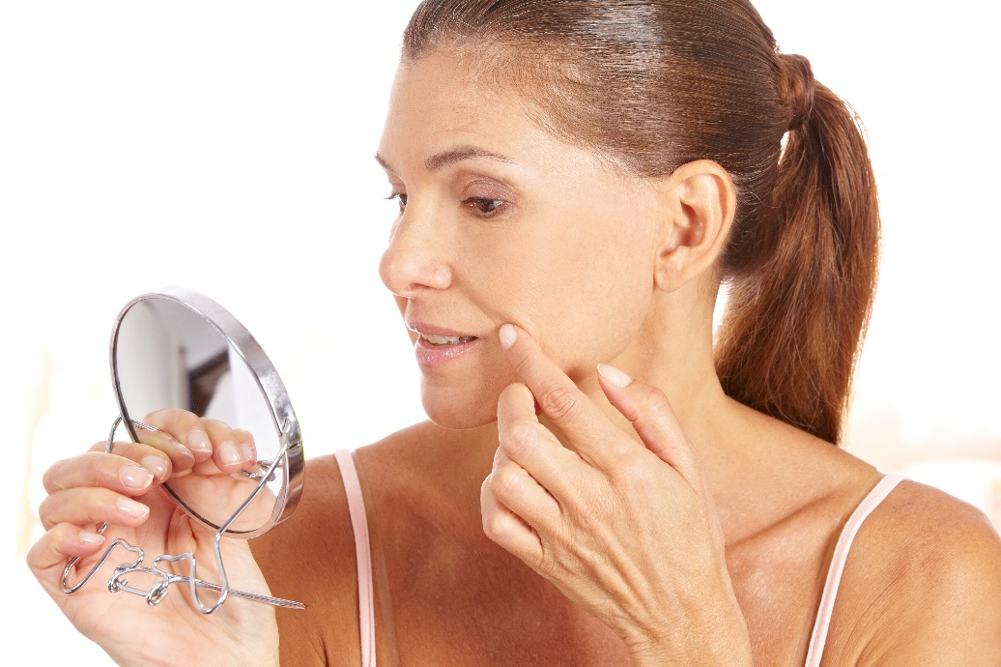
Consumers MOST bothered by…
Excess weight on any part of the body 84%
Excess fat under the chin or neck 73%
Skin texture and/or discoloration 71%
Lines and wrinkles around and under the eyes 70%
Consistent concerns for 5 years!

Slide 14
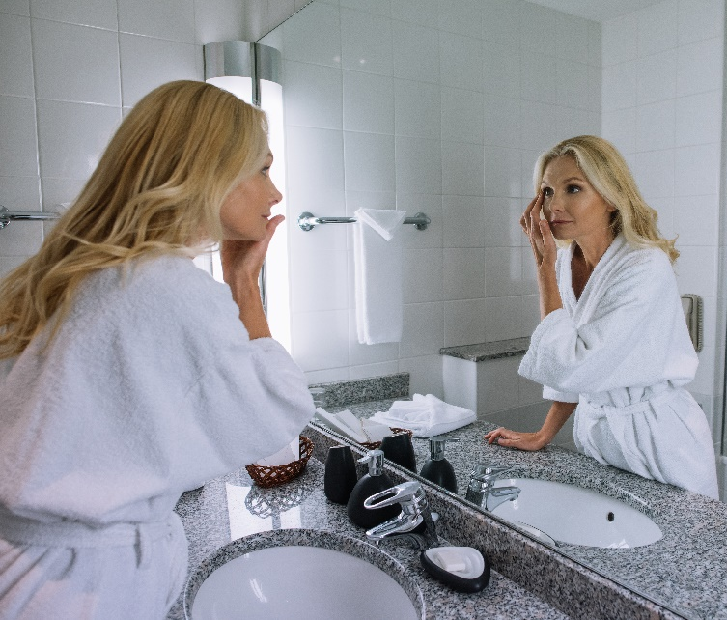
Top Procedures consumers are considering…
58% Body sculpting
56% Ultrasound, laser, light and radiofrequency treatments for skin tightening and wrinkles
51% Laser hair removal
51% Microdermabrasion
47% Injectable wrinkle-relaxers
5

Slide 15

Why are consumers WAITING?
Top 4 reasons:
Cost
May be painful
May not get the results I’m looking for
Don't know what type of practitioner to see

Slide 16
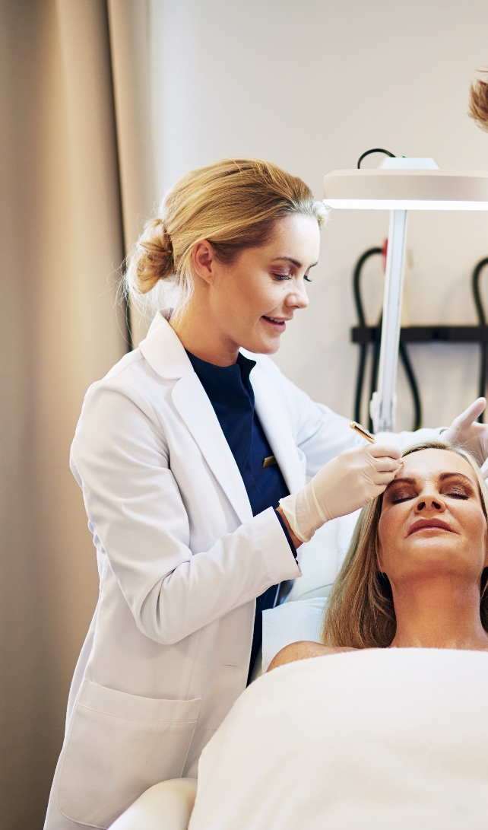
What has the most INFLUENCE on PRACTITIONER?
Top 3 of 11 factors influencing
the selection of a practitioner:
47% Price
39% SPECIALTY in which the
physician is board certified
37% Level of licensure of the
practitioner *New for 2019

Slide 17
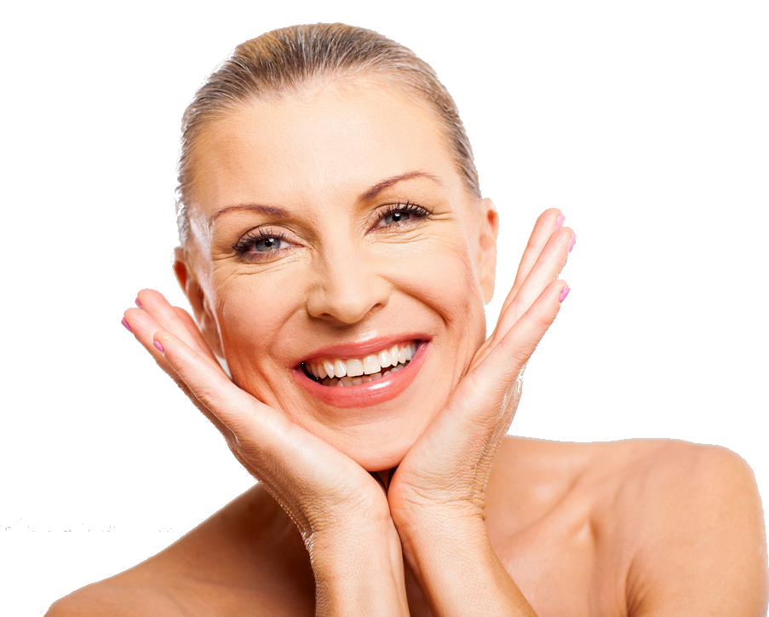
Top SATISFACTION Ratings*
Injectable wrinkle-relaxers and fillers
Chemical peels
Microdermabrasion
Laser / light therapy for skin tone
Ultrasound, laser, light and radiofrequency
treatments for skin tightening and wrinkles
Laser tattoo removal
*95% or higher

Slide 18

Monthly Cost on Personal SKIN CARE Products
Top 3 price ranges for monthly consumer spending on skin care products.
48% $1 - $50
31% $51 - $100
12% $101 - $150
© Copyright ASDS 2017.
Confidential: Do not distribute or disseminate.

Slide 19
Summary
Dermatologists are ranked as the No.1 influencer on whether to have a cosmetic procedure and for skin care decisions.
Specialty board certification repeatedly ranked as top factor influencing the selection of a practitioner.
Almost 70% of consumers are considering cosmetic procedures.
Of dermatologist physician of choice, more than 60% were an ASDS member.
Social media and rate and review sites impact consumers becoming patients.

